Slide 1

Superstore Data
-Presented by Shreya Parekh , Shubham Verma

Slide 2

Introduction
The Superstore Dataset contains the sales, profits and discounts provided by the store in different regions of the United States of America.
The dataset helps us understand how the store is performing between the years 2020 to 2022.
Our main objective here is to track and analyze sales and profit data for the company.

Slide 3

Data Analysis
As part of pre-processing : we made different combinations of data to be able to gain insights and understand the performance of the superstore.
There is a mismatch between Order Dates and Ship Dates. The ship dates are for 2018-2022 but the orders dates are between 2020-2022.
We made the dashboard on Tableau so be able to gain insights from the dataset provided based on the visualization tools.

Slide 4

Visualizations
This dataset tells us that the sales fall between October-January every year.
The sales seem to increase in March and August every year
Their main losses are caused by “tables” in the East, South and Central Zones.
They are earning the most profit in New York.
The Furniture category is giving them the most losses in the Central and East regions.
Office supplies has the highest discounts which is why the quantities sold are the highest
Phones are giving them the highest profit even though the technology category offers the lowest discounts.

Slide 5
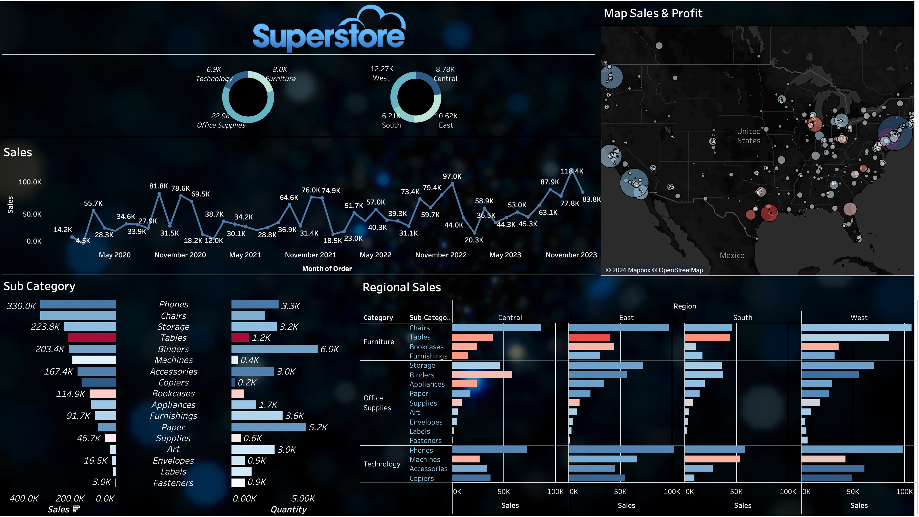

Slide 6
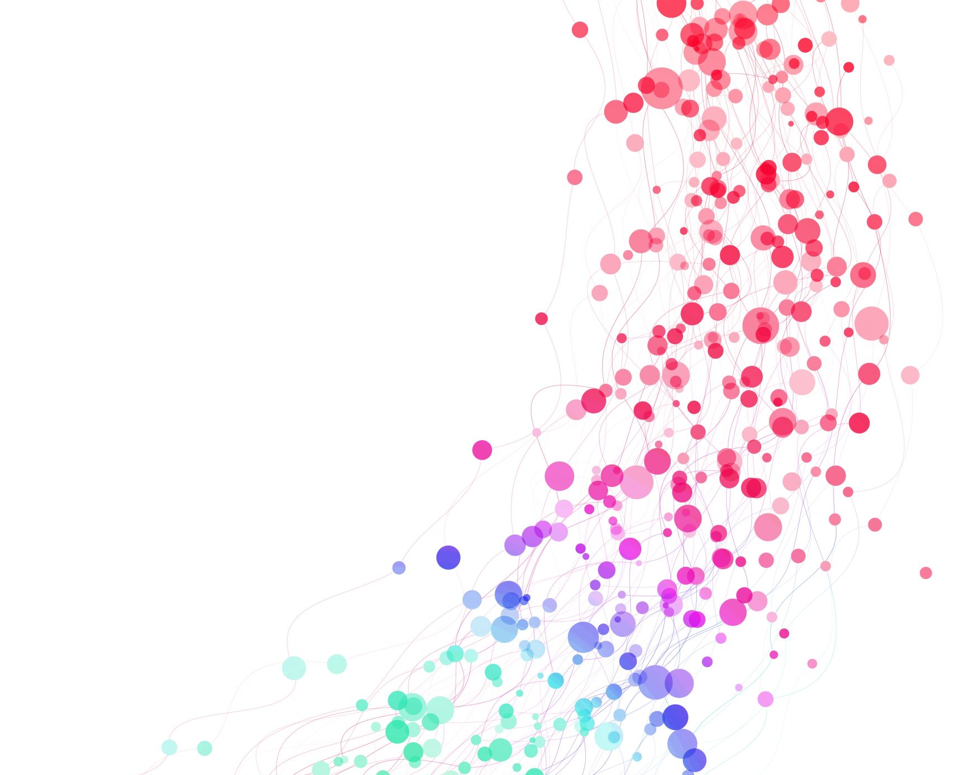
Conclusion
Superstore needs to focus on growing sales in the Technology and Office Supplies categories.
Sales in the Central region are steadily increasing, a little bit of focus on sales can take them a long way in this particular region.
The company needs to pay attention to sales in the South region since there seem to be the least sales in that region.
The company could consider expanding into new markets, such as Canada or Europe. This could be a good way to grow sales and revenue.
Company should address the cause of this decline in sales in every November and take steps to address it .

Slide 7

Thank you

